Slide 1
Rational use of medicines

Slide 2
What is rational drug use?
Rational use of medicines requires that "patients receive medications appropriate to their clinical needs, in doses that meet their own individual requirements, for an adequate period of time, and at the lowest cost to them and their community.

Slide 3
What are the steps of rational drug use?
The procedure for Rational Drug prescription comprises 6 steps:
Step 1: Determining the patient’s problem
Step 2: Determining the object of the treatment
Step 3: Verification of the suitability of the P-treatment for the specific patient
Step 4: Onset of treatment
Step 5: Information, instructions and precautions
Step 6: Monitoring (and termination) of treatment

Slide 4
P[ersonal] Medications are selected following a specific procedure:
Setting the diagnosis (Pathophysiology)
Defining therapeutic aim
Listing effective medications
Selecting groups of drugs, based on scientific evidence (EBM)
Selecting a P-medication

Slide 5
What are the advantages of rational use of medicine?
Rational medicine use strategies enhance the effective, safe, and cost-effective use of medicines, preserve the effectiveness of antimicrobials, and contribute to good health outcomes.

Slide 6
Why rational use of antibiotics is important?
The rational use of antibiotics not only concerns the actions of providers, in ensuring patients receive appropriate treatment for their condition, at the right dose and duration, but also those of patients, in adhering to the treatment regimens prescribed, completing the full course and not sharing or storing

Slide 7
What are reasons for irrational use of drugs?
There is polypharmacy, overuse of antibiotics, and the use of non-generic name drugs. Lack of continuous education, presence of comorbid diseases, and prescriber educational status were identified to have contributed to irrational drug use.

Slide 8
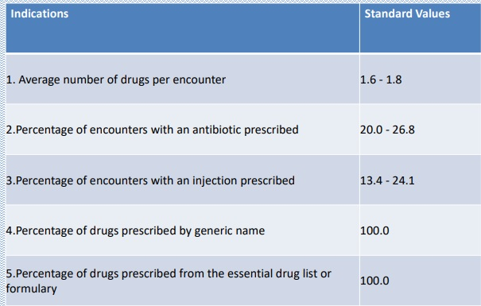
Prescribing Indicators

